Slide 1

DATABASES AND APPLICATIONS
SUBJECT CODE : UQ23CA653A
Samyukta D Kumta
Computer Applications

Slide 2
DATABASES AND APPLICATIONS
UNIT-IV- Non Relational Database Types
Wide Column / Column Family Database
Column family database store data in records with an ability to hold very large numbers of dynamic columns.
Columns can contain null values and data with different data types. In addition, data is stored in cells grouped in columns of data rather than as rows of data.
Columns are logically grouped into column families. Column families can contain a virtually unlimited number of columns that can be created at run-time or while defining the schema.
Column families are groups of similar data that is usually accessed together.

Slide 3
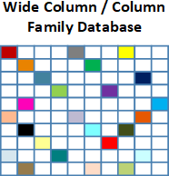
DATABASES AND APPLICATIONS
UNIT-IV- Non Relational Database Types
Data is stored in columns instead of rows as in a conventional relational database management system (RDBMS).
The names and format of the columns can vary from row to row in the same table.
A wide column database can be interpreted as a two-dimensional key-value.

Slide 4
DATABASES AND APPLICATIONS
UNIT-IV- Non Relational Database Types
Column family databases do not utilize table joins that are common in traditional RDMS, they tend to scale and perform well even with massive amounts of included data. And databases with billions of rows and hundreds or thousands of columns are common.
When Similar data comes in same place offer better compression
Example Google sheet, Excel sheet

Slide 5
DATABASES AND APPLICATIONS
UNIT-IV- Non Relational Database Types
For example,
A Geographic information systems (GIS) like Google Earth may a row ID for every longitude position on the planet and a column for every latitude position. Thus, if one database contains data on every square mile on Earth, there could be thousand of rows and thousands of columns in the database. And most of the columns in the database will have no value, meaning that the database is both large and sparsely populated.

Slide 6
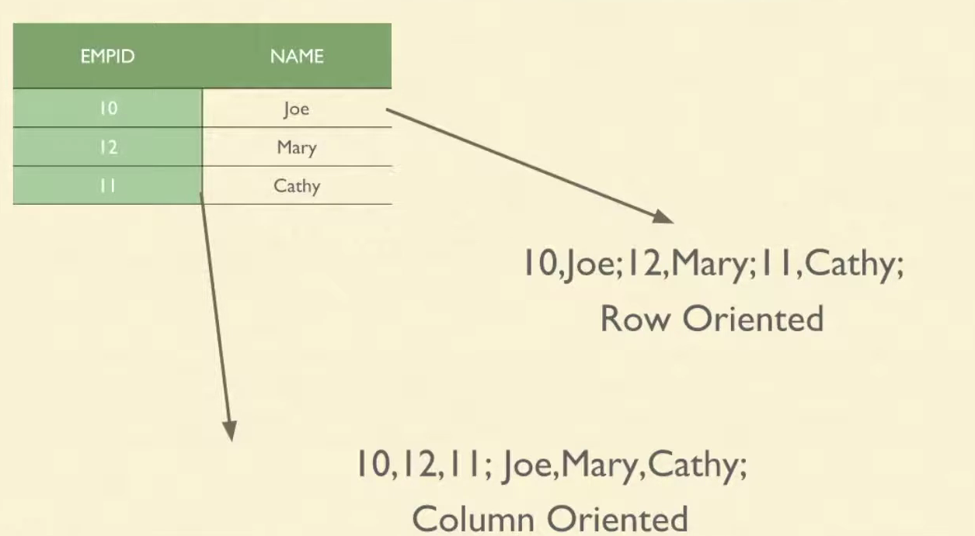
DATABASES AND APPLICATIONS
UNIT-IV- Example of Column Family Database
Traditional Way of storing Data in Row oriented

Slide 7
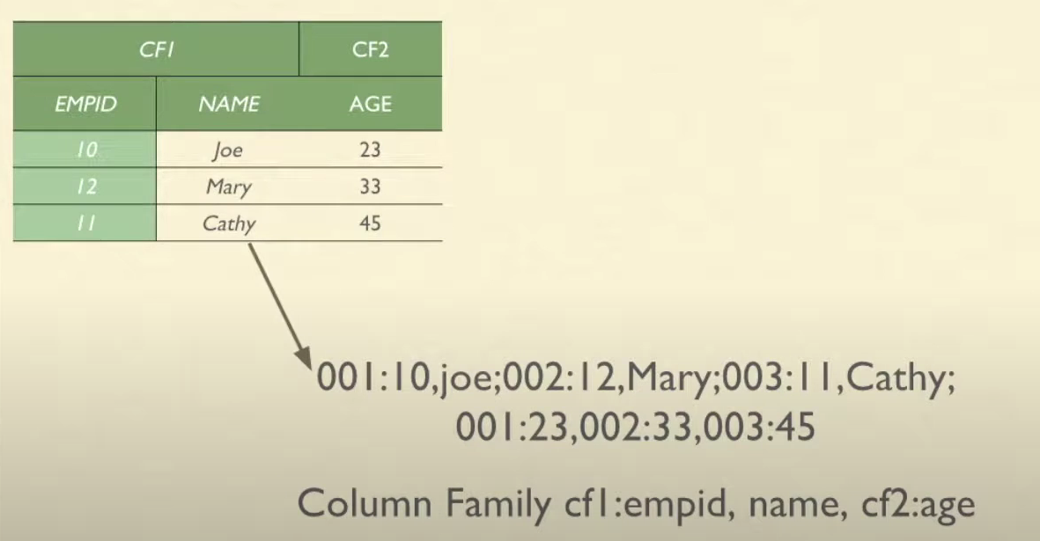
DATABASES AND APPLICATIONS
UNIT-IV- Example of Column Family Database
Data stored in Column family database(Hybrid Storage)

Slide 8
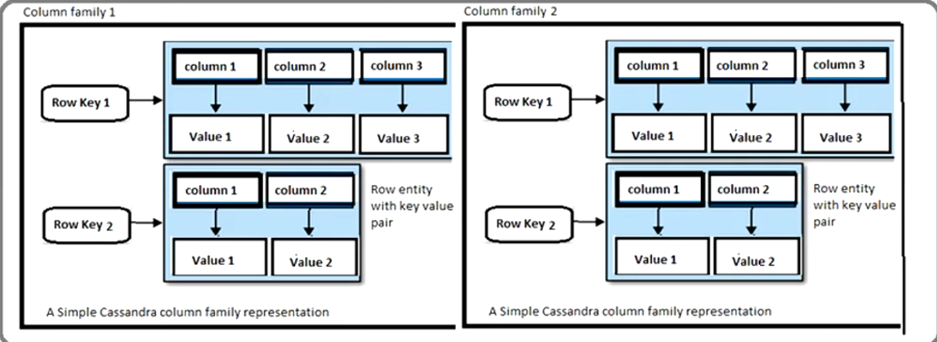
DATABASES AND APPLICATIONS
UNIT-IV- Example of Column Family Database
Data stored in CASSANDRA Column family database

Slide 9
DATABASES AND APPLICATIONS
UNIT-IV- Non Relational Database Types
Column Family Databases
Hbase
Cassandra
HyperTable
They are commonly used in applications such as real-time analytics, sensor data storage, and high-volume transactional systems where scalability and performance are critical.

Slide 10

THANK YOU
Samyukta D Kumta
Department of Computer Applications
samyuktad@pes.edu

